Slide 1
FORCE AND MOTION
4TH GRADE

Slide 2
What will this help me learn?
S4P3. Students will demonstrate the relationship between the application of a force and the resulting change in position and motion on an object.
b. Using different size objects, observe how force affects speed and motion.
c. Explain what happens to the speed or direction of an object when a greater force than the initial one is applied.
d. Demonstrate the effect of gravitational force on the motion of an object.
S4CS1. Students will be aware of the importance of curiosity, honesty, openness, and skepticism in science and will exhibit these traits in their own efforts to understand how the world works.
b. Carefully distinguish observations from ideas and speculation about those observations.
c. Offer reasons for findings and consider reasons suggested by others.

Slide 3
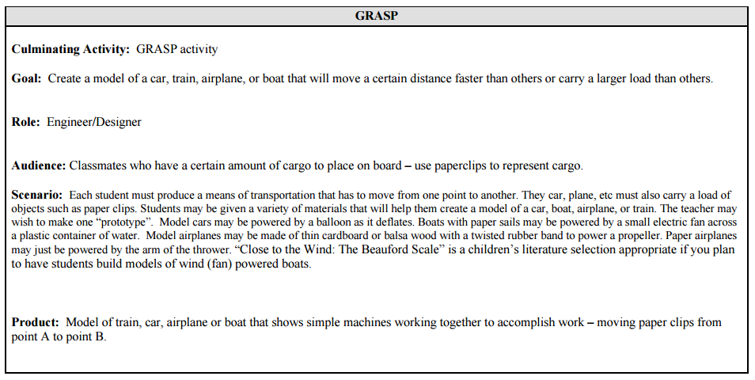
Your Challenge:

Slide 4
Directions:
Test your vessel. Place SPRK+ inside your vessel, and use the joystick to test your creation.
You will only have 10 minutes to practice driving your SPRK+ and to modify your vessel.
Estimate how many “passengers” (ones blocks) your vessel can transport from starting point to ending point. Record in STEM journal.
Use a roll command, record your variables, and attempt to carry 20 passengers to the other side.
Continue to modify your roll command’s variables until you find the combination that transports the most passengers from one side to the other.
Record your variables and results during each trial.

Slide 5
Share data…
What can you conclude about the correlation between force and motion?
Refer to data you just gathered and discuss findings with your teammates.
Share whole group

