Slide 1
Bee Bots
Introduction to Bee Bot Programming

Slide 2
Parts of the Bee Bot
Forward Button

Slide 3
Parts of the Bee Bot
Rotate Buttons

Slide 4
Parts of the Bee Bot
Go Button

Slide 5
Parts of the Bee Bot
Clear-Start Over Button

Slide 6
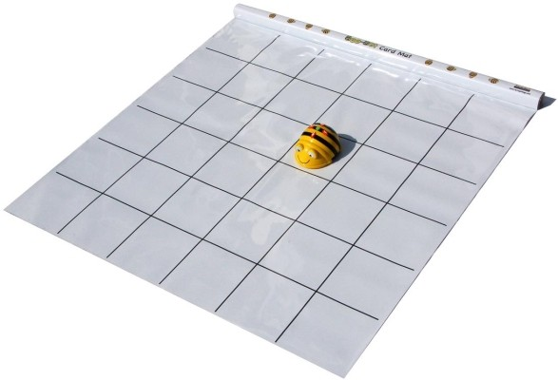
Bee Bot Mat

Slide 7
How to make the Bee Bot Move
Forward makes the Bee Bot move one space in the direction it is facing
It will only move one space for each time you push the button
Forward Button

Slide 8
How to make the Bee Bot Move
The two side arrows make the Bee Bot turn in place.
It will stay in the same square

Slide 9
How to make the Bee Bot Move
The Bee Bot will not do any moving until you hit go.

Slide 10
How to make the Bee Bot Pause
The pause button makes the Bee Bot take a break. If you want your Bee Bot to pause for a moment in the middle of your code, the button will make him stop for a moment then continue the code you programmed.
This is part of the code.
You can not hit this button to make the Bee Bot stop once it is running.

Slide 11
Don’t Forget to Clear
Don’t forget to clear the Bee Bot before each code.
If you forget to clear, it will first do the previous code then run yours.
This button will show up as an “X” on most Bee Bots.

Slide 12
Practice one
Roll the dice
Pick up the Bee Bot, place it in the top square in the same row as your number.
Hit the Forward Arrow the number of times you need it to move to get to the number you rolled.

Slide 13
Lesson 2: Rotating
To rotate the Bee Bot, you hit one of the turn buttons
The turn buttons do not move the Bee Bot forward, it just rotates in place
After it turns, then you hit the forward arrow the number of places you would like it to move

Slide 14
Practice Two
Roll the dice
Pick up the Bee Bot, place it in the top row
Hit the Forward Arrow the number of times you need it to move to get to the number you rolled.
When the next person rolls the dice, they do not pick up the Bee Bot, instead they make the Bee Bot go to the number starting from the last players number

